Slide 1


Microeconomics I Topic 11: Game Theory
Assistant Professor He Tai-Sen
ts.he@ntu.edu.sg
Notes:
Lecture time: 1 hr 10 mins

Slide 2
Outline
What is a game (in game theory)?
Normal form games
Dominant strategy equilibrium
Nash equilibrium
Extensive form games

Slide 3

What is a game?
Game theory is collection of tools for predicting outcomes for a group of interacting agents, where the action of a single agent directly affects the payoffs of other participating agents.
Game theory is especially useful when the number of interactive agents is small, in which case the action of each agent may have a significant effect on the payoff of other players.
Noncooperative games
Normal form games
Extensive form games
Notes:
4

Slide 4
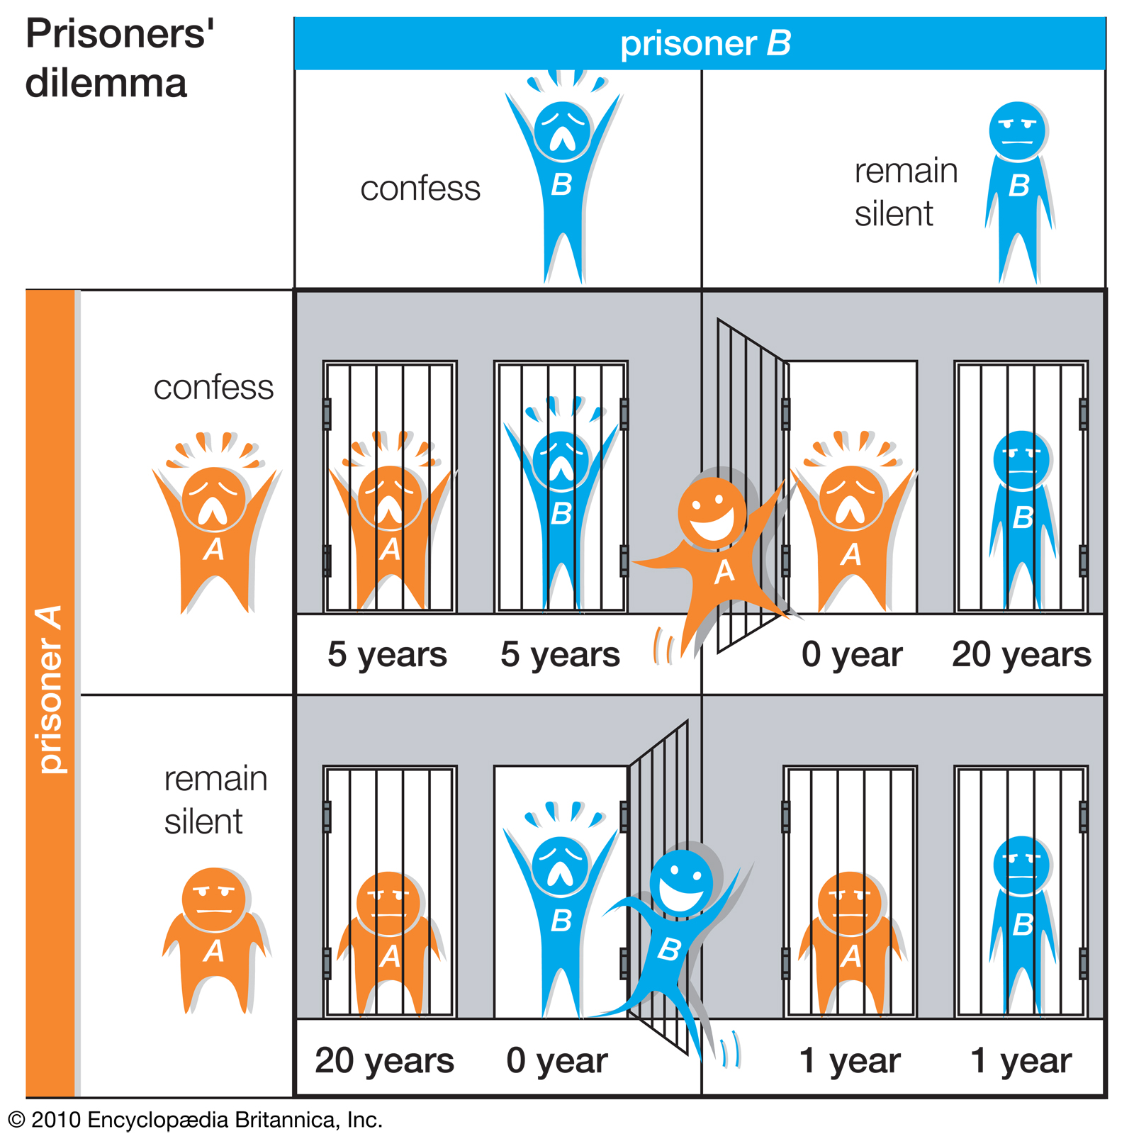
Normal form games
Elements of a game:
Players (Player A and Player B)
Action/Strategy
Payoff (Player A’s payoff, Player B’s payoff)
Payoff matrix
Player B
 | Confess | Remain silent
Confess | ( , ) | ( , )
Remain silent | ( , ) | ( , )
Player A
Notes:
4

Slide 5
Normal form games
Dominant strategy: a strategy that is optimal no matter what an opponent does
Dominant strategy equilibrium: Outcome of a game in which each player is doing the best it can regardless of what the other player is doing. [I’m doing the best I can no matter what you do. You’re doing the best you can no matter what I do.]
Player B
 | Confess | Remain silent
Confess | (1,1) | (5,0)
Remain silent | (0,5) | (3,3)
Player A
Notes:
4

Slide 6
Normal form games
Please find the dominant strategy equilibrium.
Step 1: Find Player A’s dominant strategy
If Player B chooses to Confess, player A’s best action is to confess.
If Player B chooses to Remain Silent, player A’s best action is to confess.
=> Player A’s dominant strategy is to confess.
Step 2: Find Player B’s dominant strategy
If Player A chooses to Confess, player B’s best action is to confess.
If Player A chooses to Remain Silent, player B’s best action is to confess.
=> Player B’s dominant strategy is to confess.
Player B
 | Confess | Remain silent
Confess | (1, 1) | (5, 0)
Remain silent | (0, 5) | (3, 3)
Player A
Notes:
4

Slide 7
Normal form games
Please find the dominant strategy equilibrium.
Step 1: Find Firm A’s dominant strategy
If Firm B chooses to Advertise, Firm A’s best action is to advertise.
If Firm B chooses to Don’t Advertise, Firm A’s best action is to advertise.
=> Firm A’s dominant strategy is to advertise.
Step 2: Find Firm B’s dominant strategy
If Firm A chooses to Advertise, Firm B’s best action is to advertise.
If Firm A chooses to Don’t Advertise, Firm B’s best action is to advertise.
=> Firm B’s dominant strategy is to advertise.
Firm B
 | Advertise | Don’t advertise
Advertise | (10,5) | (15,0)
Don’t advertise | (6,8) | (10,2)
Firm A
Notes:
4

Slide 8
Normal form games
Please find the dominant strategy equilibrium.
Step 1: Find Firm 1’s dominant strategy
If Firm 2 chooses Crispy, Firm 1’s best action is sweet.
If Firm 2 chooses Sweet, Firm 1’s best action is crispy.
=> Firm 1’s dominant strategy is no.
Step 2: Find Firm 2’s dominant strategy
If Firm 1 chooses Crispy, Firm 2’s best action is sweet.
If Firm 1 chooses Sweet, Firm 2’s best action is crispy.
=> Firm 2’s dominant strategy is no.
Firm 2
Cereal | Crispy | Sweet
Crispy | (-5,-5) | (10,10)
Sweet | (10,10) | (-5,-5)
Firm 1
Notes:
4

Slide 9
Normal form games
Nash equilibrium: I’m doing the best I can given what you are doing. You’re doing the best you can given what I’m doing.
Please evaluate all four possible outcomes.
Solve Nash equilibrium using the underline method.
Firm 2
Cereal | Crispy | Sweet
Crispy | (-5,-5) | (10,10)
Sweet | (10,10) | (-5,-5)
Firm 1
Notes:
4

Slide 10
Normal form games
Nash equilibrium is a stable choice where no player has a good reason to change their strategy, given what the other players are doing.
A game needs not have a single Nash equilibrium.
Dominant strategy equilibrium is a special case of Nash equilibrium.
A dominant strategy equilibrium is also a Nash equilibrium.
A Nash equilibrium is not necessarily a dominant strategy equilibrium.
Notes:
4

Slide 11
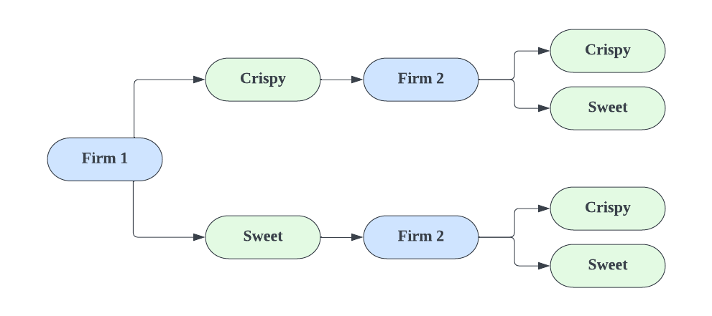
Extensive form games
Players move sequentially: One player moves first and the other player moves second after observing the first player’s action.
Subgame perfect equilibrium
step 1
(-5, -5)
(10, 20)
(20, 10)
(-5, -5)
step 2
step 1
Notes:
4
Backtracking:
As Firm 1, you know
Firm 2 will produce Sweet if I (Firm 1) produces Crispy >> (Crispy, Sweet)
Firm 2 will produce Crispy if I (Firm 1) produces Sweet >> (Sweet, Crispy)
Since I (Firm 1) want to maximise my payoff, I will choose the higher payoff for myself between (Crispy, Sweet) i.e. (10,20) and (Sweet, Crispy) i.e. (20,10)
My higher payoff is __________ and hence I will produce __________.

Slide 12
Extensive form games
Solving it by backward induction
Step 1: Firm 2’s best-response function:
If Firm 1 chooses Crispy, then Firm 2’s best action is to choose sweet.
If Firm 1 chooses Sweet, then Firm 2’s best action is to choose crispy.
Step 2: Firm 1 chooses its best action based on Firm 2’s best-response function:
If Firm 1 chooses Crispy, then Firm 2 will choose sweet. Firm 1’s payoff=10.
If Firm 1 chooses Sweet, then Firm 2 will choose crispy. Firm 1’s payoff = 20.
=>Firm 1’s best action is to choose sweet.
Notes:
4

